Slide 1
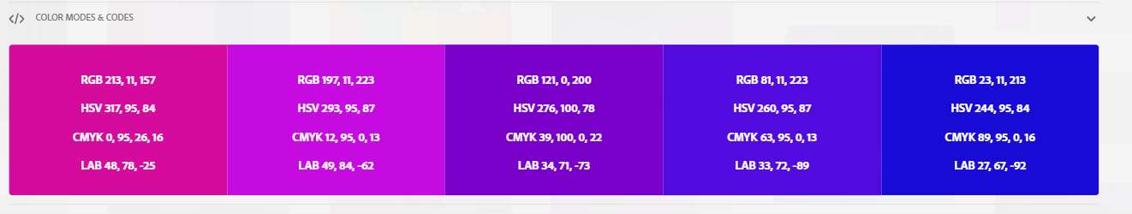
Machine Learning Model Deployment
How to deliver Machine Learning from Experiment to solutions
Benedictus Aryo

Slide 2
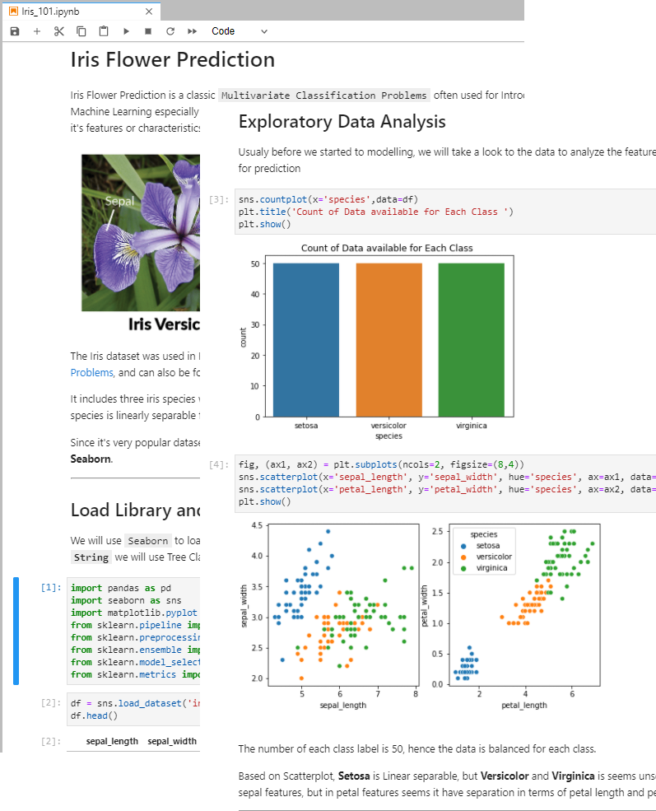
Let’s imagine this scenario
After finishing your Analysis on a dataset and finally you created the best performance machine learning model in Jupyter Notebook.
How can people make use of your result ?

Slide 3
Can we just send them the Jupyter notebook files and let them run it ?
They should have Anaconda or Jupyter Notebook / Lab installed right ?

Slide 4
Depends on..
Are the users know how to set up Python Environment ?
Yes
Are the users need to know python programming ?
Yes
Are the users Data Scientist or Machine Learning Engineer who want to know your process of thinking?
Yes
Then Just send the Jupyter Notebook Files ☺
No
No
No
No
Then we need to make something else

Slide 5

Questions to help us consider
What are the machine learning solution purposes?
Who are the users?
What is their level of knowledge?
Where the solution will be run ?
What is the requirement ?

Slide 6







Then We can make a choice
Script / Console App
NO
YES
GUI/
Desktop Application
Need Graphical User Interface ?
Run Local / Offline
Interactive Web App
API /
Web Server
Machine Learning Solutions
NO
Simple
Need Graphical User Interface ?
YES
Complexity & Security
Complex
Run on Network / Internet
Full Website with Database and Login

Slide 7
Run on Local / Offline App
Python Script
Model Deployment using Console Script is the most easiest and common method to serve the functionality of the program.
Script usualy purposed to do automation or scheduling which doesn't need UI Interface.
Desktop GUI using DearPyGUI
Model Deployment using Desktop GUI using python can become an options if we want to make a Desktop GUI Application so that user can interact with the application interface such as slider and button.

Slide 8
Run on Network / Internet
Web API using Flask
In some cases we may need more powerfull hardware to do computation so by providing Web Service/API, existing user application like android app can just send REST Request for machine learning prediction
Interactive Web App using Streamlit
If we want to serve the Prediction application in the server as a web application so that it will be accessible through the network/internet and also user can freely access and interact to the machine learning interface directly, we can make Interactive web application.
Full Website with Database & Login
If we want to make our web app can store data in database format and also make access restriction to only some user that allowed to use the machine learning app, we can create Full Website that allow us to utilize database and manage user access.

